Slide 1
Web Applications
INFWEB01-D and INFWEB21-D

Slide 2
Motivation
Implementing reliable software can be a difficult process, why?
Notes:
- How are applications implemented? Think of code, files and database running on one or multiple machines
- Such a process is usually separated into phases to improve detecting errors for each implemented components
- Beside errors that are produces by programming the software itself others could be made through configuring or programming the network and infrastructure
- In order to detect errors correctly additional knowledge about networking and Infrastructure is needed.

Slide 3
Motivation
Recent development of web applications and the infrastructure around it has implication on the design and the implementation of software
With recent development we mean cloud computing:
Infrastructure as a service IaaS (for example hardware)
Platform as a service PaaS (for example a servers)
Software as a service SaaS (for example web shops)
How is this development implicating the application development?

Slide 4
Networking
What is a computer network?
Notes:
Computer network is a telecommunications network which allows computers to exchange data
Data are transmitted as a bit of streams or as a network packet that is a formatted unit of data (a list of bits or bytes)

Slide 5
Networking
What is a computer network?
Networks are characterized through their organizational purpose:
Local area network (LAN) which is usually limited to a building
Wide area network (WAN) which extends over a large geographical distance
Virtual Private network (VPN) which uses tunneling to connect to another network
How are data transmitted in the network?
Notes:
Computer network is a telecommunications network which allows computers to exchange data
Data are transmitted as a bit of streams or as a network packet that is a formatted unit of data (a list of bits or bytes)

Slide 6
Network Layers and Data Flows
Internet protocol suite IP/TCP provides end-to-end data communication
This functionality is organized into four abstraction layers
Notes:
A voip call uses typically a UDP connection.
The data flows in the networks starting from host one (A) until it reaches host (B)
It might flow through some routers between host (A) and (B)

Slide 7
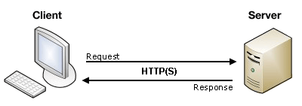
Client-Server Architecture
Web applications is a client–server computer program
A server node runs one or more server programs which share their resources with clients
A client node does not share any of its resources, but requests a server's content or service function
Notes:
A distributed application structure is a partition of the tasks or workloads between servers, and service requesters, called clients

Slide 8
Network Protocols
Client-server communication is implemented using different network protocols.
What is the function of a protocol?
Notes:
Your application must respect the specification of the used protocols.
An example of such used protocols are IP, TCP, UPD, HTTP
We will look closer to some protocols in the following slides.
Syntax (data format and coding)
Semantics (control information and error handling)
Timing (speed matching and sequencing)

Slide 9
Network Protocols
Client-server communication is implemented using different network protocols.
What is the function of a protocol?
Notes:
Your application must respect the specification of the used protocols.
An example of such used protocols are IP, TCP, UPD, HTTP
We will look closer to some protocols in the following slides.
Syntax (data format and coding)
Semantics (control information and error handling)
Timing (speed matching and sequencing)

Slide 10
Question
What are the basic ingredients of a web application?

Slide 11
Web Applications
The basic ingredients of a web application are:
Protocols: in addition to IP/TCP or IP/UDP it uses HTTP (Hypertext Transfer Protocol)
Component files:
Code files: websites are built primarily from HTML, CSS, and JavaScript. Other programming languages (C#, Java, etc.) could be used to generate the website.
Assets/Resources: this is a collective name for all the other stuff that makes up a website
Servers: web server and databases if necessary
Notes:
HTTP is an application protocol that defines a language for clients and servers to speak to each other. This is like the language you use to order your goods.
:A website is made up of many different files, which are like the different parts of the goods you buy from the shop. These files come in two main types: Code files, Assets
Assets: such as images, music, video, Word documents, and PDFs.

Slide 12
Example of Client-Server Implementation
Suppose we use Postman application to connect the following URL: https://jsonplaceholder.typicode.com/posts
What are the two ends of this communications?
Can you describe the functionalities provided at each end?

Slide 13
Question
What is the difference between dynamic and static web applications?
How would you separate the functionality of your application for simultaneous development and code reuse?

Slide 14
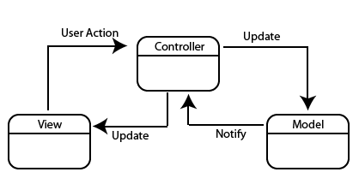
Model-View-Controller (MVC)
Many modern web applications use the MVC architectural pattern to allow:
simultaneous development,
and code reuse
The main idea is to partition an applications into three parts:
The Model
The View
the Controller
What is the purpose of the Model?
Notes:
Motivation: Use divide and conquer to simplify among the parts of a program
- Defines the role the objects play in an application into one of three parts
- Defines the way objects communicate with each other

Slide 15
The Model in MVC
The central component of the pattern
It is the application's dynamic data structure, independent of the user interface
It directly manages the data and the logic to interact with a database provider
Notes:
Talk about the state of each component -> the state of the view could be different than the state of the model

Slide 16
The Model in MVC..
Two general ways to implement the Model:
Tightly coupling the data-access code to a database provider like MySQL using SQL
Adding another abstraction layer, which is database provider independent, using object-relational mapper (ORM)
In this course we will use the later by mean of using:
Entity Framework Core: object-relational mapper
Language-Integrated Query (linq): a data query language that have a type checking at compile type

Slide 17
Introduction to Object-Relational Mapper
Modern approaches are based on a mapping between the data structures of the host programming language and those of the model
"O" because mainstream languages (C++, Java, C#) are still object-oriented

Slide 18
Introduction to Object-Relational Mapper..
ORM automatically translates tables into classes, columns into attributes, and classes and attributes back into tables and columns;
Models also feature relations between entities:
For instance 1-N relation, where one entity of a type is logically connected to many entities of another type
Example: Course 1 - N Lectures
EF Core uses two additional design pattern to minimize duplicate query logic when processing data
Repository pattern
Unit of work pattern

Slide 19
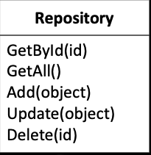
Repository Pattern
Repository encapsulates the set of objects persisted in a data store and the operations performed over them
It centralize common data access functionality
It encapsulate the logic required to access data source

Slide 20
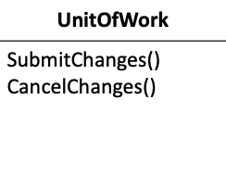
Unit of Works Pattern
When you're pulling data in and out of a database, it's important to keep track of what you've changed
A Unit of Work keeps track of everything you do during a transaction that can affect the database
It maintains a list of new, changed and deleted objects.
It coordinates persisting changes can be used across multiple repositories

Slide 21
Repository and Unit of Works in EF Core
A DbContext instance represents a session with the database and can be used to query and save instances of your entities
It combines unit of work and repository patterns

Slide 22
Live Example
Implement a console application for a movie database:
Relationship: movie 1<->N actor
Relationship: movie N<->N actor

